Slide 1
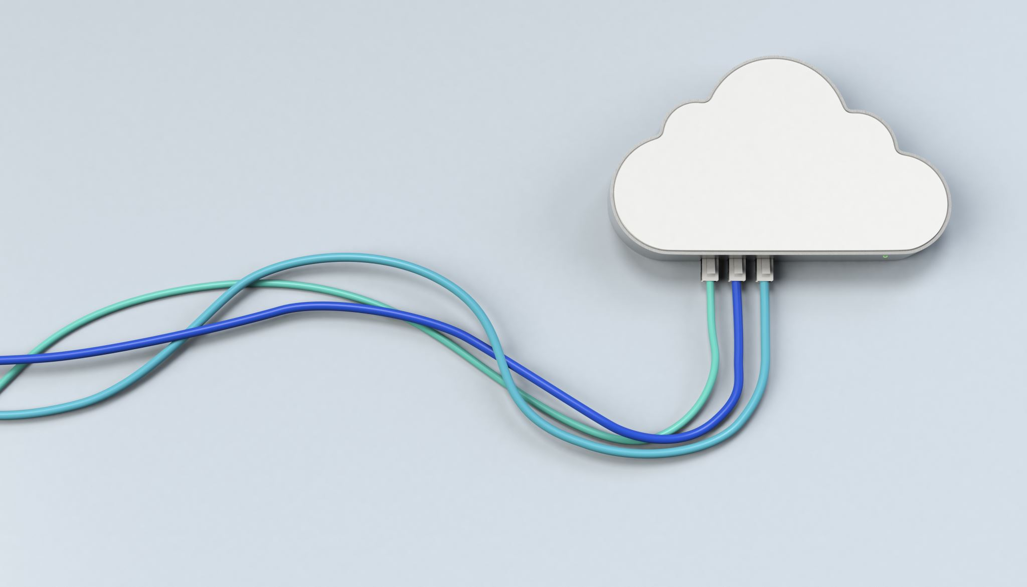
Introduction to Cloud Computing
Week 8
Cloud Virtualization, Resource Management & Scaling
CS-4037
Muhammad Sudais
muhammad.sudais.v@nu.edu.pk

Slide 2
CHAPTER 7 Resource Virtualization
|Cloud Computing

Slide 3

Introduction to Virtualization
Key Concept: Virtualization is the process of simulating physical computing resources, allowing multiple virtual computers to run on a single set of physical resources.
Benefits: Optimizes resource utilization, enhances security, and provides abstraction.
Main Enabler: The hypervisor plays a critical role in creating and managing virtualized resources.

Slide 4
What is Virtualization?
Definition: Virtualization creates a layer of software (the virtualization layer) over physical resources, transforming them into a simulated form.
Concept: Users interact with these virtualized resources, fulfilling computing needs through a logical abstraction rather than physical access.
Example: A single physical processor can be virtualized to appear as multiple processors to the user.

Slide 5

Virtualizing Physical Computing Resources
Resource Virtualization: Physical resources like CPU, memory, storage, and network devices can be virtualized.
Example: Virtual processors, memory, and storage are presented to users, abstracted from the underlying physical hardware.
Software Component: The control programs (software) create virtual machines (VMs), enabling the installation of guest operating systems.

Slide 6

Understanding Abstraction
Abstraction in Virtualization: The process of hiding the complexity of physical computing resources, presenting a simplified virtual resource to users.
Importance: This layer of abstraction makes cloud services more flexible and reliable.
Operating Systems: Guest operating systems are installed on virtual machines, functioning as though on physical hardware.

Slide 7
Business Benefits of Virtualization
Cost Savings: Virtualization reduces hardware costs and improves server utilization.
Survey: A Ziff-Davis survey found that over 75% of respondents identified lower hardware costs as the primary driver for adopting virtualization.
Main Driver: Server virtualization is the key technology behind resource optimization in businesses.

Slide 8
Machine or Server Level Virtualization
Definition: Server virtualization allows multiple operating systems (guest systems) to run on a single physical machine (host system).
Host vs. Guest: The host system runs the hypervisor, while guest systems are independent virtual machines running on the hypervisor.
Example: Different operating systems can run on the same physical server.

Slide 9
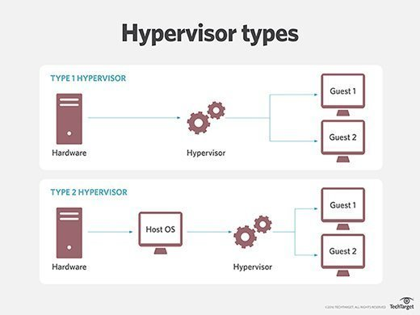
Hypervisor and Virtual Machine Monitor (VMM)
Hypervisor Role: Creates and manages the virtual environment, allowing multiple VMs to share physical resources.
Two Types of Hypervisors:
Type 1 (Bare Metal): Runs directly on the hardware.
Type 2 (Hosted): Runs on a host operating system.

Slide 10
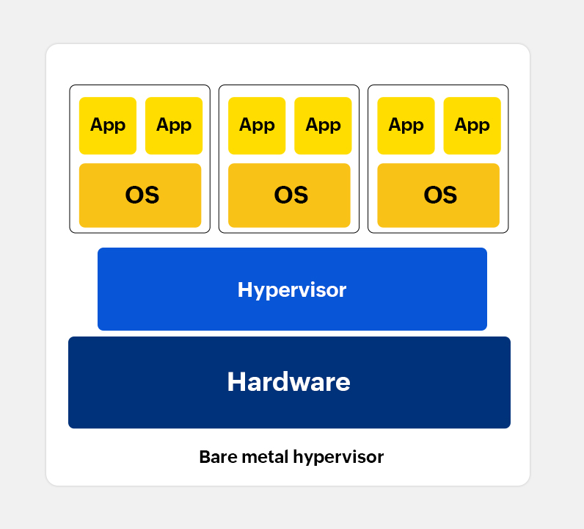
Bare Metal Approach (Type 1 Hypervisor)
Bare Metal Hypervisor: Directly installed on physical hardware, offering better performance and control.
Benefits: More suitable for enterprise-level applications and advanced resource management.
Examples: VMware ESXi, Microsoft Hyper-V, Xen.

Slide 11
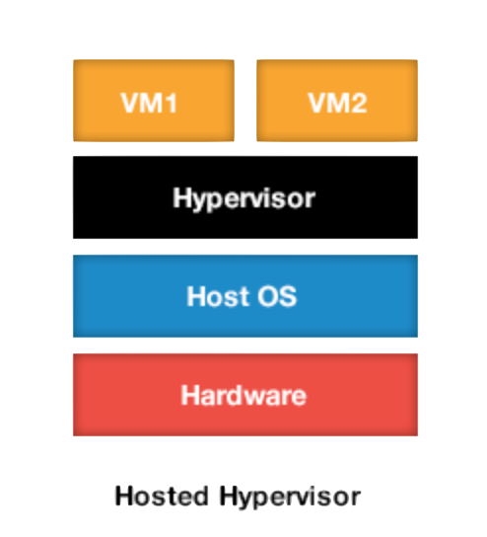
Hosted Approach (Type 2 Hypervisor)
Hosted Hypervisor: Installed on top of a host OS, making it easy to install and configure for various hardware platforms.
Drawbacks: Lack of direct access to hardware degrades VM performance. Not ideal for real-time OS support.
Examples: VMware Workstation, Microsoft Virtual PC.

Slide 12
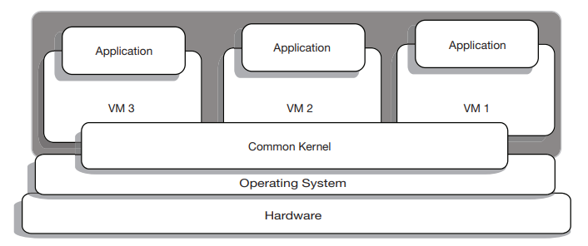
Operating System Level Virtualization
Definition: OS-level virtualization enables multiple user-space instances using a single OS kernel.
Key Point: No hypervisor needed, shares the same kernel across virtual servers.
Examples: FreeBSD’s Jail, Linux VServer, OpenVZ.

Slide 13

Advantages of OS-Level Virtualization
Lighter Weight: All virtual servers share the same kernel, so they consume fewer resources.
Efficient Resource Utilization: Supports more virtual servers compared to complete VMs.

Slide 14

Limitations of OS-Level Virtualization
Same OS Requirement: All virtual servers must use the same OS kernel.
Limited Flexibility: Different OS distributions (e.g., Linux distros) allowed, but no cross-OS flexibility.

Slide 15
OS-Level Virtualization vs. Machine Virtualization
OS-Level: Same OS for all virtual servers, shared kernel.
Machine Virtualization: Allows different OS instances, uses hypervisor (e.g., VMware, Hyper-V).

Slide 16
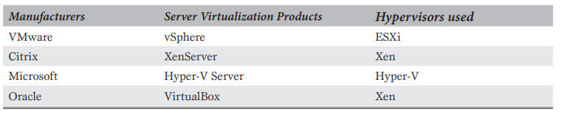
Major Server Virtualization Products
VMware vSphere: Enterprise-level solution using ESXi hypervisor.
Citrix XenServer: Open-source virtualization using Xen hypervisor.
Microsoft Hyper-V: Built into Windows Server, uses Hyper-V hypervisor.
Oracle VirtualBox: Supports various guest OS using Xen-based architecture.
KVM: Open-source hypervisor built into the Linux kernel.

Slide 17
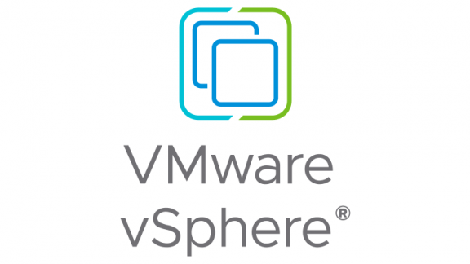
VMware vSphere
Overview: Leading product for data center virtualization.
Hypervisor: Uses Type 1 (bare-metal) ESXi hypervisor.
Features: Centralized management through vCenter Server.

Slide 18
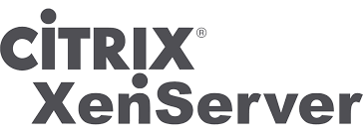
Citrix XenServer
Overview: Open-source, para-virtualization based solution.
Hypervisor: Based on Xen, widely used in cloud platforms like Amazon EC2.
Acquisition: Citrix acquired XenSource Inc. in 2007.

Slide 19
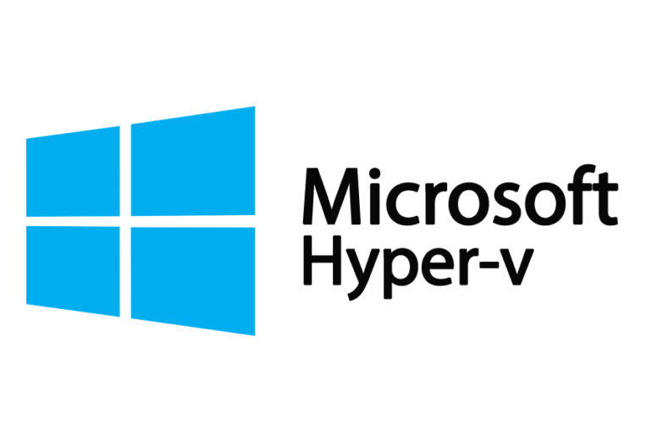
Microsoft Hyper-V
Overview: Part of Windows Server ecosystem.
Hypervisor: Type 1 hypervisor, Hyper-V.
History: Launched in 2008 as part of Windows Server.

Slide 20
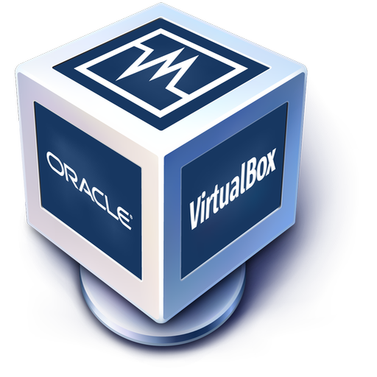
Oracle VM VirtualBox
Overview: Open-source virtualization, formerly Sun VirtualBox.
Hypervisor: Xen-based, runs on various OS platforms.
Features: Supports a wide range of guest operating systems.

Slide 21
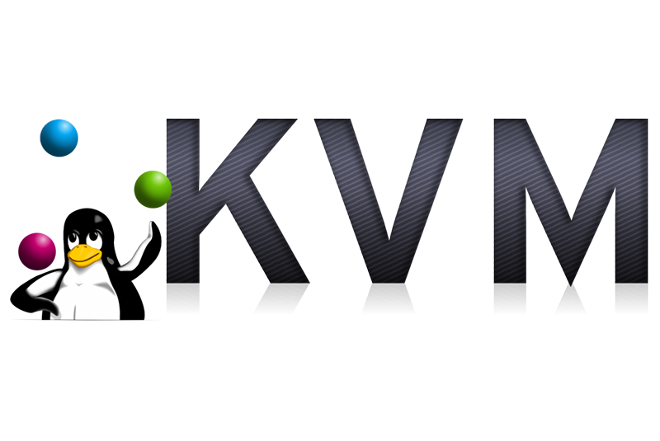
KVM
Overview: Open-source hypervisor type 2, integrated into Linux kernel.
Guest OS Support: Linux, Windows, UNIX.
Developed by: Red Hat, part of Linux since version 2.6.20.

Slide 22
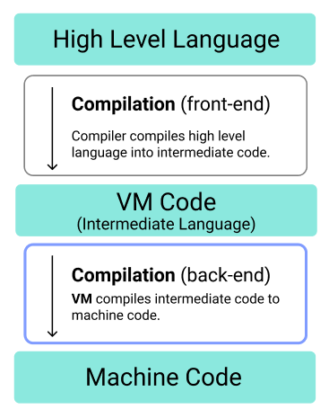
High-Level Language Virtual Machine (HLL VM)
Definition: A virtual machine that abstracts the instruction set architecture (ISA) and operating system, easing porting of compilers and applications across platforms.
Key Benefits:
Intermediate representation allows portability.
Abstract machine translates intermediate code to physical instructions.
Examples:
Java Virtual Machine (JVM)
Common Language Runtime (CLR) by Microsoft
Use Case: Allows Java and .NET applications to run on various platforms, decoupled from specific hardware.

Slide 23
HLL-VM as Application Virtualization
Definition: Process or application virtualization isolates an application from the underlying system, creating a controlled, secure environment.
Sandboxing: Restricts the application's interaction with system resources, often used for security and testing.
Examples:
Java applications run in JVM.
UCSD P-System, an early portable OS.

Slide 24
Emulation
Definition: Emulation allows one system to mimic another, enabling software designed for one architecture to run on another.
Techniques:
Binary Translation: Converts binary code for one architecture to another.
Interpretation: Slower but easier, translating instructions as they are encountered.
Examples:
Microsoft VirtualPC
QEMU (Quick EMUlator)

Slide 25
Emulation vs. Simple Virtualization
Emulation:
Focus: Simulates hardware/software of a different architecture.
Requires instruction set translation.
Slower due to the need for binary translation.
Simple Virtualization:
Focus: Virtualizes the native environment with no instruction set translation.
Faster, near-native performance.
Example: Native virtual machines running Linux or Windows without translation.

Slide 26
Other Types of Virtualization
Network Virtualization:
Combines network resources into a single virtual network.
Examples: Virtual LAN (VLAN), Virtual Private Network (VPN).
Storage Virtualization:
Pools physical storage into virtualized storage systems.
Examples: SAN, Google Cloud Storage, Azure Storage.
Desktop Virtualization:
Separates applications from the desktop.
Example: VMware Fusion for running Windows on a Mac.

Slide 27
Advantages of Virtualization
Better Resource Utilization: Enables server consolidation and optimizes hardware usage.
Cost Reduction: Lowers hardware and infrastructure costs.
Improved Fault Tolerance: Virtual machines can be migrated in case of hardware failure.
Simplified System Administration: Easier management of resources and systems.
Legacy Support: Enables running outdated applications on modern platforms.

Slide 28
Downsides of Virtualization
Single Point of Failure: If the host system fails, multiple virtual machines may be affected.
Performance Overhead: Virtual machines may achieve 85-90% of the native performance.
Complexity: Troubleshooting and root cause analysis can be more difficult with an additional virtualization layer.

Slide 29
Virtualization Security Threats
Host Vulnerability: A breach at the physical host level affects all VMs.
Hypervisor Attacks: Compromising the hypervisor can jeopardize the entire environment.
Inactive VMs: Dormant VMs can pose a risk if they contain sensitive data but are not monitored.
Privilege Escalation: Attackers may gain higher access than allowed through the hypervisor.

Slide 30
Virtualization Security Recommendations
Host Hardening: Apply best security practices to the physical host.
01
Hypervisor Protection: Secure the hypervisor to prevent attacks on the virtual environment.
02
Monitor Inactive VMs: Ensure dormant virtual machines are secured or removed.
03
Zone Separation: Maintain separation between virtual machines of different trust levels.
04

Slide 31
Virtualization and Cloud Computing
Virtualization as a Foundation for Cloud Computing:
Virtualization technologies are integral to cloud computing, enabling cloud providers to optimize resource use.
It abstracts the physical infrastructure, allowing the cloud to offer flexible, scalable services.
Key Benefits in Cloud Computing:
Resource Efficiency: Maximizes hardware use through virtual machines.
Scalability: Easily scale up or down by adding or removing virtual machines.
Cost Savings: Cloud providers offer pay-as-you-go models, powered by virtualization.
Isolation & Security: Virtualization ensures isolated environments for different users.

Slide 32
CHAPTER 8 Resource Pooling, Sharing and Provisioning
|Cloud Computing

Slide 33
Pooling – Sharing – Provisioning
Resource Pooling
Resource pooling is a core feature of cloud computing that allows cloud providers to serve multiple clients using shared physical resources.
Key Concepts:
Resources like computing power, storage, and network bandwidth are virtualized and pooled.
Clients use these virtual resources without being aware of the underlying physical infrastructure.
Key Benefits:
Increased resource utilization.
Cost-efficiency by eliminating idle resources.
Flexibility to meet fluctuating demands.
Example: Multiple virtual machines (VMs) running on a single physical server.
Resource Sharing
Resource sharing allows multiple clients or workloads to use the same set of physical resources.
Benefits:
Higher Utilization Rates: Shared resources ensure maximum usage of physical infrastructure, reducing idle time.
Cost Efficiency: Instead of each client needing separate resources, they share resources, driving down costs.
Elasticity: Resources are dynamically allocated based on demand.
Example: A cloud provider like AWS or Azure shares physical servers among numerous clients using virtualization technologies.
Dynamic Resource Provisioning
Dynamic Provisioning: The ability of the cloud provider to allocate or release resources on demand, ensuring the right amount of resources is available at any time.
How It Works:
Resources are provisioned when an application or client needs more capacity.
Resources are de-provisioned when demand decreases, ensuring efficiency.
Advantages:
No need for over-provisioning hardware.
Reduces costs and improves agility.
Perfect for workloads with varying resource demands.
Example: A retail website may require more server capacity during the holiday season and less afterward.

Slide 34
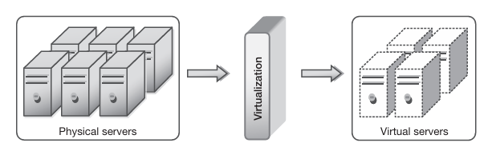
Resource Pooling Architecture
Resource Pools: Collections of virtualized resources that include processing power, memory, storage, and networking.
Components:
Compute Pool: Virtual servers that run applications and workloads.
Storage Pool: Virtualized storage that is allocated to users.
Network Pool: Virtual networking resources like bandwidth and routers.
How It Works:
Resources from physical machines are abstracted into a virtual pool.
This pool can dynamically allocate resources to VMs or containers.

Slide 35
Computer and Server Pools in Cloud Data Centers
Definition: A collection of physical servers that host virtualized computing environments.
Process:
Physical machines are grouped into a compute pool.
Virtual machines (VMs) or containers are created from these servers.
Resources like CPU and memory are allocated based on demand.
Benefits:
Efficient resource utilization.
Easy scalability by adding more servers to the pool.
Example: A company using multiple VMs to run different applications from a shared server pool.

Slide 36
Storage Pools in Cloud Environments
Storage Pool: A virtualized collection of physical storage devices (e.g., SSDs, HDDs) that act as a single storage unit.
How It Works:
Cloud providers pool storage from multiple devices to create virtual disks for users.
Data from various users are stored on the same physical storage but are isolated at the virtual layer.
Benefits:
Storage can be expanded or reduced without physical reconfiguration.
Higher availability and reliability through redundancy (e.g., RAID configurations).
Example: Google Cloud Storage providing scalable object storage for applications.

Slide 37
Network Pools in Cloud Data Centers
Network Pool: A collection of virtualized network components, including routers, switches, and firewalls.
How It Works:
Virtual networks (VLANs) are created by pooling physical networking equipment.
Users can configure their own virtual networks within the cloud.
Benefits:
Simplifies networking in large, complex environments.
Increases security through network segmentation.
Example: Amazon VPC (Virtual Private Cloud) allows users to define their own isolated networks in the cloud.

Slide 38
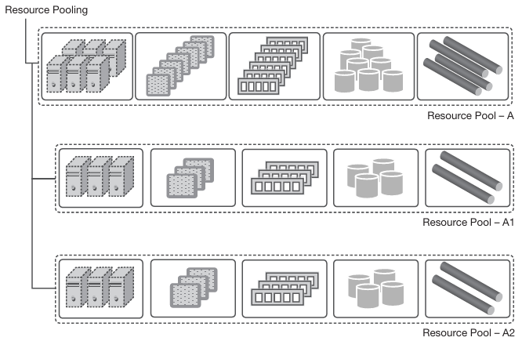
Hierarchical Organization of Resource Pools
Hierarchy of Pools: Resource pools are often organized into sub-pools for better management and scalability.
Structure:
Parent Pools: Larger pools containing resources for broader use.
Sub-pools: Smaller pools within the parent pools for specific purposes (e.g., different applications).
Benefits:
Enhanced scalability.
Fault tolerance by distributing workloads across multiple pools.
Efficient management of diverse workloads.
Example: An enterprise cloud may have a parent compute pool with sub-pools for different departments or applications.

Slide 39
Commoditization of Data Centers
Commoditization: Cloud providers use inexpensive, standardized hardware (commodity servers) instead of specialized hardware.
Key Features:
Lower cost of hardware.
Easy replacement and scalability.
Cloud platforms are built to handle hardware failures without affecting service.
Benefits:
Reduces capital expenditure for cloud providers.
Increases scalability as commodity hardware is easily replaceable.
Example: Facebook and Google’s data centers largely rely on commodity hardware for their cloud services.

Slide 40
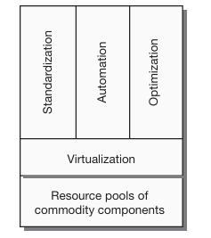
Standardization, Automation, and Optimization
Standardization: Uniform resource types (CPU, memory, storage) across the cloud environment ensure compatibility and predictability.
Automation: Cloud systems automatically manage resource allocation, monitoring, scaling, and recovery.
Optimization: Continuous adjustments to resource allocation ensure efficient use of resources while maintaining performance.
Benefits:
Reduces manual intervention.
Ensures optimal performance with minimal cost.
Example: Automatic horizontal scaling of VMs when traffic increases on a web app.

Slide 41
Resource Sharing
Multiple clients or applications share physical resources while maintaining isolation through virtualization.
Challenges:
Resource contention can affect performance.
Ensuring fair distribution of resources to all clients.
Solutions:
Performance Isolation: Techniques like capping resource usage for each client.
QoS Guarantees: Contracts that ensure clients get a minimum level of service.
Example: Virtual machines on AWS sharing CPU cores, but each VM gets a dedicated memory pool.

Slide 42
Multi-Tenancy in Cloud Computing
Definition: A single instance of a cloud platform serves multiple customers (tenants), with data and applications logically separated.
Public Cloud Example:
Users share infrastructure, but their resources are isolated through virtualization.
Benefits:
Cost-effective for cloud providers.
Tenants can scale without affecting each other.
Challenges:
Ensuring security and performance isolation between tenants.
Example: Salesforce.com, where each organization using the service has isolated data and applications on a shared infrastructure.

Slide 43
Challenges of Resource Sharing
Performance Issues:
Contention for CPU, memory, or network resources can degrade application performance.
Ensuring Quality of Service (QoS) in shared environments.
Solutions:
Virtual Machine Monitor (VMM): Manages resource allocation among VMs.
Load Balancing: Dynamically redistributes workloads to avoid bottlenecks.
Future Direction: Use of AI/ML algorithms to predict resource needs and optimize allocation in real-time.
Example: Google Cloud’s use of AI-based optimizations for real-time resource management.

Slide 44
Resource Provisioning
Traditional computing requires significant time and effort for provisioning servers.
Modern computing leverages cloud and virtualization for rapid provisioning.
Cloud enables flexible, dynamic, and self-service provisioning of resources.
Benefits of Cloud Resource Provisioning:
Saves time and reduces administrative overhead.
Flexible and dynamic allocation of resources.
Virtual machine provisioning enables rapid deployment.
Resources can be provisioned through a self-service interface.

Slide 45
Autonomic Resource Provisioning
Automated process using artificial intelligence (AI).
Cloud providers allocate resources based on demand.
Resources are pooled and shared, allowing dynamic allocation.
Minimizes resource waste and optimizes application performance.

Slide 46
Role of SLAs in Resource Provisioning
SLAs define the expected resource capacity for applications.
Cloud providers plan resources based on combined SLAs.
Provisioning algorithms dynamically map VMs to physical resources.
Efficient resource estimation ensures smooth performance.

Slide 47
Resource Provisioning Approaches
Static Resource Provisioning
Suitable for predictable workloads.
Resource allocation happens once during application start.
No runtime decision overhead but cannot adapt to changing demands.
Can lead to over-provisioning or under-provisioning issues.
Dynamic Resource Provisioning
Resources allocated and de-allocated based on current demand.
Provides elasticity, enabling applications to scale up or down.
Resources are pooled and shared, minimizing wastage.
Suitable for fluctuating workloads but introduces runtime decision overhead.
Hybrid Resource Provisioning
Combines static and dynamic approaches.
Initial resource allocation is static; dynamic adjustments occur during runtime.
Addresses the challenges of real-time workload changes.
Balances resource utilization and system performance.

Slide 48
Comparison of Static and Dynamic Provisioning
Static Provisioning:
One-time resource allocation.
No elasticity or scaling.
No runtime overhead.
Dynamic Provisioning:
Resources adjusted based on demand.
Elastic and scalable.
Runtime overhead due to resource allocation decisions.

Slide 49
Over & Under Resource Provisioning
Resource Under-provisioning
Occurs when resources are insufficient for application demand.
Leads to performance degradation and application slowdowns.
Requires careful planning to prevent resource shortages.
Often addressed with dynamic provisioning techniques.
Resource Over-provisioning
Resources exceed actual demand, leading to wastage.
Increases costs without benefiting performance.
Common in static provisioning models to avoid under-provisioning.
Dynamic provisioning mitigates this issue by returning unused resources to the pool.

Slide 50
Cloud Resource Provisioning Plans
Short-Term On-Demand Plan:
Resources are provisioned as needed, with pay-per-usage pricing.
Dynamic provisioning approach, ideal for fluctuating demand.
Long-Term Reservation Plan:
Resources are reserved in advance, reducing computational complexity.
Fixed pricing for a set period, suitable for predictable workloads.

Slide 51
VM Sizing in Cloud Computing
Correct sizing of VMs is essential for optimal resource utilization.
Over-provisioning and under-provisioning can lead to inefficiencies.
Dynamic VM provisioning ensures resources match real-time demand.
Proper VM sizing helps balance cost and performance.

Slide 52
CHAPTER 9 Scaling in the Cloud
|Cloud Computing

Slide 53
Scaling in the Cloud
What is Scaling?
Resource virtualization enables dynamic resource provisioning.
Dynamic provisioning allows scalability of systems and applications.
Systems must efficiently manage resources to balance performance and cost.
Scaling is the ability of a system or function to grow or shrink as required.
Importance: Handles varying workloads without impacting performance or cost.
A scalable system can handle workload increases without performance degradation.

Slide 54
Scalability Metrics
Maximum workload a system can handle is its scalability limit.
Scalability is constrained by system architecture and hardware resources (CPU, memory, disk I/O).
A system's scalability is its ability to maintain performance under increasing demand.

Slide 55
Traditional Computing Scaling
Resource capacity was enhanced manually and remained static even if underutilized.
Resource wastage occurred due to the lack of dynamic infrastructure.
Static scaling often required system restarts, making it inefficient.
Capacity was planned for peak demand, leading to resource wastage.

Slide 56
Cloud Computing Scaling
Dynamic and automatic scaling is possible in the cloud.
Cloud systems adjust capacity without system restarts.
Cloud gives the impression of infinite scalability with virtualized resources.
Reversible Scaling in the Cloud
Dynamic provisioning enables resources to be added or removed on the fly.
Both upward and downward scaling are essential for cost-efficiency.
Downward scaling is more challenging but critical for maintaining performance.

Slide 57
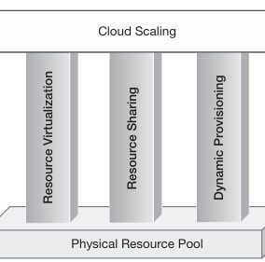
Foundation of Cloud Scaling
Cloud scaling relies on three main pillars:
Resource virtualization: Simplifies management.
Resource sharing: Enables optimal utilization.
Dynamic provisioning: Ensures on-demand scalability.
Together, these create a flexible, scalable cloud system.

Slide 58
Scalable Application Architecture
Applications must be designed for scalability.
Scalable system architecture alone is not enough.
Scalable applications use efficient algorithms, data structures, and database systems.

Slide 59
Scaling Strategies in Cloud
Dynamic scaling happens either manually or automatically.
Auto-scaling is the core feature of cloud scaling, adjusting capacity based on demand.
Two types of auto-scaling:
Proactive scaling: Scheduled, based on expected demand.
Reactive scaling: Adjusts in real-time based on resource utilization.

Slide 60
Proactive Scaling
Anticipates resource demand in advance based on pre-defined schedules.
Two subtypes:
Proactive cyclic scaling: Scales based on regular intervals.
Proactive event-based scaling: Scales during known business events like campaigns.
Ensures resources are provisioned in anticipation of demand spikes.

Slide 61
Reactive Scaling
Adjusts capacity based on actual resource utilization in real-time.
Adds or removes resources automatically when certain thresholds are met (e.g., CPU or memory usage).
More efficient for handling unpredictable or sudden workload spikes.

Slide 62
Benefits of Cloud Scaling
Optimized performance and cost-efficiency through automatic scaling.
Reduced downtime due to the dynamic adjustment of resources.
Flexibility to handle unpredictable workload patterns.
Infinite scalability illusion created by dynamic resource pools.

Slide 63
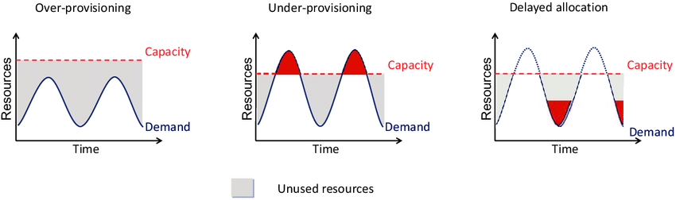
Challenges in Cloud Scaling
Scaling down is more challenging than scaling up.
Performance must be maintained when releasing resources.
Overprovisioning due to inaccurate scaling predictions.

Slide 64
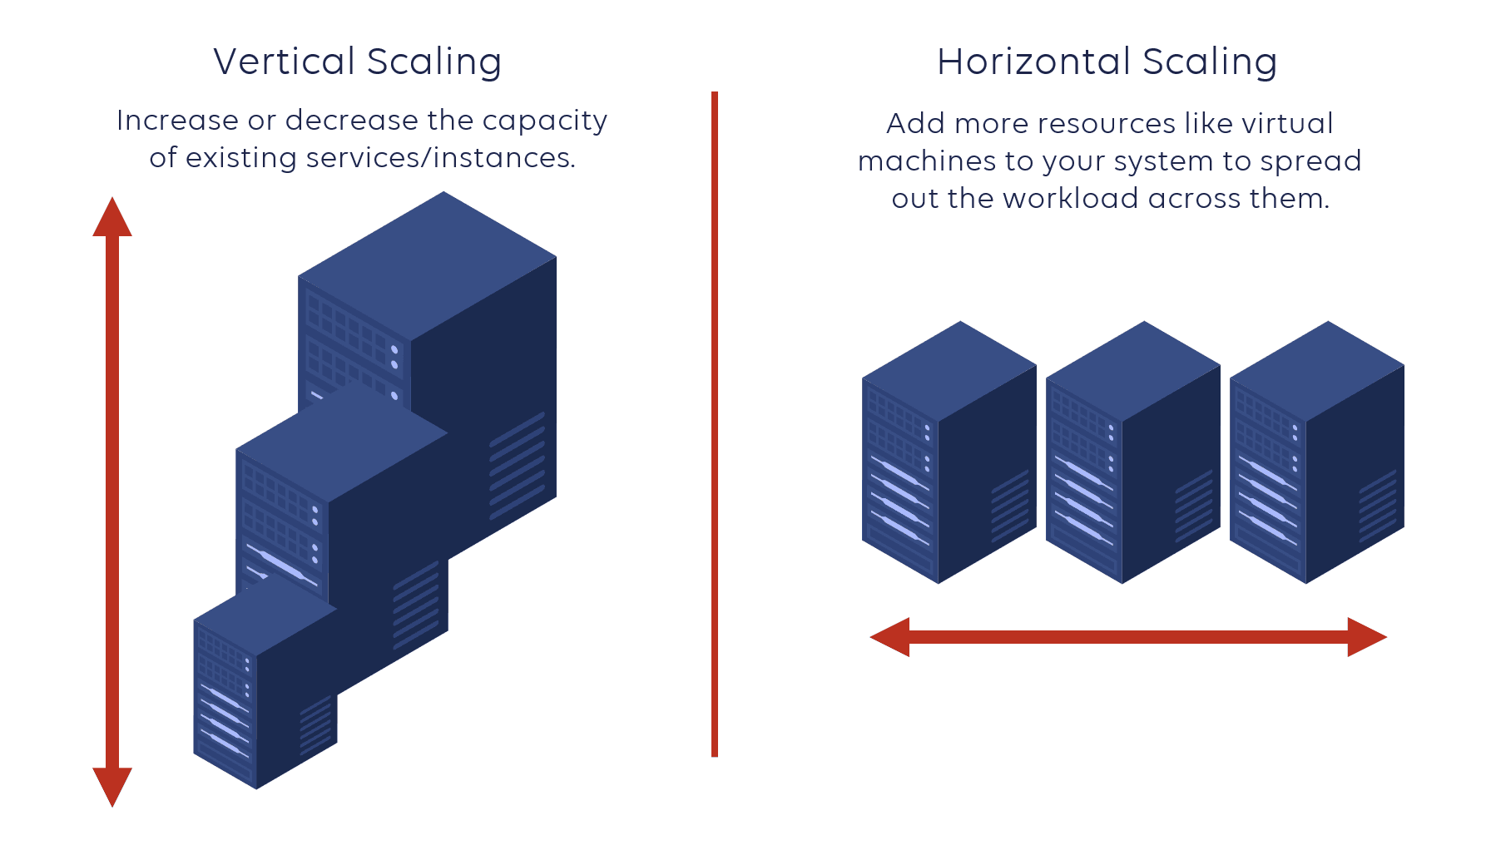
Type of Scaling
Vertical Scaling (Scaling Up)
Horizontal Scaling (Scaling Out)

Slide 65
Vertical Scaling
Overview
Definition: Vertical scaling, or scaling up, involves enhancing the capacity of existing resources by upgrading components.
Example: Replacing a dual-processor with a quad-processor to increase processing power.
How Vertical Scaling Works
Upgrading hardware components (CPU, RAM) within a single node.
Increasing resource capacity without altering the system architecture.
Advantages of Vertical Scaling
Simplicity: Easier to implement with less complexity in management.
Less Risk: Minimal disruption to existing architecture and services.
Familiar Environment: Utilizes existing system setup with upgraded components.
Disadvantages of Vertical Scaling
Cost: High-performance hardware can be expensive and may not be affordable.
Upper Limit: Resources have maximum capacities, leading to potential shortages.
Downtime Risk: Replacing hardware may cause service interruptions and downtime.

Slide 66
Horizontal Scaling
Overview:
Definition: Horizontal scaling, or scaling out, involves adding more resources to the system without replacing existing ones.
Example: Adding additional dual-processor servers to increase total processing power.
How Horizontal Scaling Works
Introducing additional nodes (servers) to distribute load.
Each new node operates alongside existing nodes, increasing overall capacity.
Advantages of Horizontal Scaling
No Downtime: New nodes can be added without service interruption.
Cost-Effective: Utilizes commodity hardware, reducing overall expenses.
Unlimited Scalability: Additional resources can be added without dependency on individual component capabilities.
Disadvantages of Horizontal Scaling
Complexity: Managing numerous distributed nodes can increase system complexity.
Design Challenges: Existing applications may need redesigning for a distributed architecture.
Synchronization: Requires effective load balancing and synchronization between nodes.

Slide 67
Scaling – ANALOGY & TRADE-OFF
Road Infrastructure Analogy:
Vertical Scaling: Upgrading road quality (e.g., better materials) for higher speed (like upgrading hardware).
Horizontal Scaling: Widening roads to accommodate more lanes (adding more servers).
Trade-offs: Decision depends on:
Computational Requirements: System architecture and application design.
Business Factors: Cost, availability, and performance needs.
Flexibility: Both scaling types can be used together based on specific use cases.
Feature | Vertical Scaling | Horizontal Scaling
Known As | Scaling Up | Scaling Out
Method | Replace components | Add more components
Implementation | Any computing environment | Distributed environments only
Complexity | Lower management complexity | Higher due to more nodes
Service Interruption | May cause downtime | No downtime
Hardware Type | High-end hardware | Commodity hardware
Cost | Can become very expensive | More economical and scalable

Slide 68
Cloud-Native Scaling - Horizontal
Cloud Scalability Promise: Horizontal scaling supports infinite scalability without the constraints of vertical scaling.
Auto-Scaling: Automatically adding/removing resources based on load is more aligned with horizontal scaling.

Slide 69
Performance vs. Scalability
Performance: User experience in terms of response time.
Scalability: Ability to maintain performance as user load increases.
Key Insight: An application can be scalable but not necessarily performant.

Slide 70
Resource Contention Problem
Definition: Issues arise when multiple users compete for limited resources, causing bottlenecks.
Stress Points: Identify areas where performance may degrade under load:
Network bandwidth
Application server speed – Process and Memory Speed
Database I/O
Solution: Addressing these bottlenecks through careful design and resource management.

Slide 71
Cloud Bursting and Flexible Scaling
Definition: Cloud bursting allows for temporary resource scaling into the cloud during peak demand.
Example Scenario: An application that runs on-premises can utilize cloud resources during high traffic periods.
Benefits: Provides flexibility and can optimize costs during off-peak periods.

